Slide 1
Insurance Premium Prediction
By Robin Mitra

Slide 2
Content
▪ Objectives
▪ Architecture
▪ Data set
▪ EDA
▪ Data Pre-Processing
▪ Model Building & evaluation
▪ Feature importance
▪ Model Deployment
▪ Key Performance Indicators (KPI)
▪ Q & A

Slide 3
Objective
The goal of this project is to give an estimate of how much they need on their individual health situation and Build a solution that should able to predict the premium of the personal for health insurance
Benefits :
Gets idea about how much amount required annually according to their own of health status.
This can help a person in focusing more on the health aspect of an insurance.
Help in giving premium of health insurance.

Slide 4
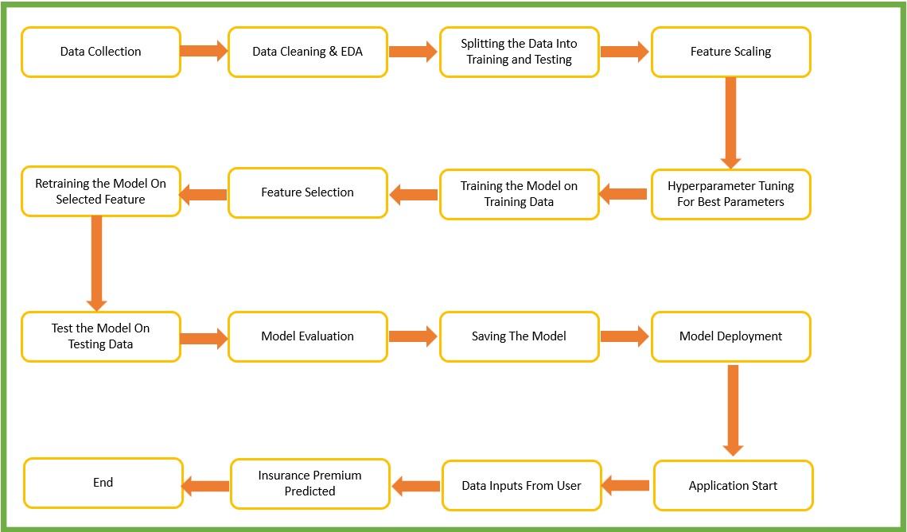
Architecture

Slide 5
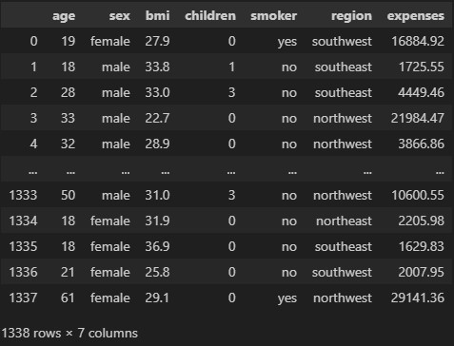
Data Set
For training and testing the model, I used the public data set available in Kaggle, “Insurance Premium Prediction” by nursnaaz
URL: https://www.kaggle.com/noordeen/insurance-premium-prediction

Slide 6
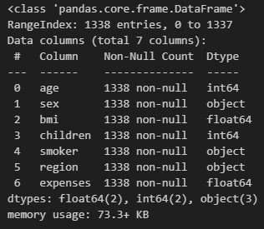
EDA- Data Cleaning
• The given data set has 7 features and each one is quantitative in nature.
• This data set doesn’t have any missing values.
• The shape of the data set is 1338 rows × 7 columns.

Slide 7
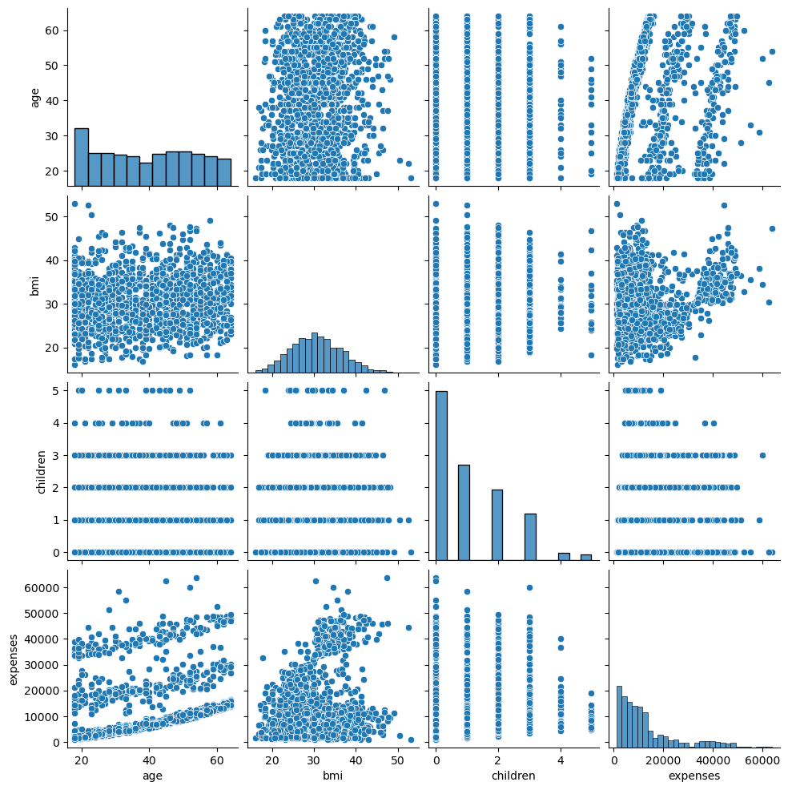
EDA- Data Visualization
• Age values are constrained between 18-64 years.
• BMI values varies from 16 to53.1
• Age & BMI have spread datapoints.
• With age expenses are also increasing following linear positive relationship.
• With number of children expenses also follow linear positive relationship.

Slide 8
Data Pre-Processing
• Split the data-frame into the training (75% of the data) and testing (25% of the data) data-frames respectively.
• For building linear regression models, used the scaled data obtained by scaling the features using the Standard scaler. Tree models use the original data i.e., without scaling as they aren’t affected by the feature scaling.
• Then both the training and testing data-frames were further split into X_train,X_test, y_train and y_test. Here the data-frames with X indicate independent features while those with y. indicate the dependent or the target feature.

Slide 9
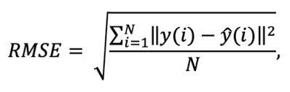
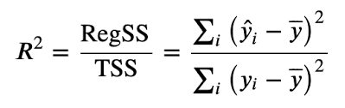
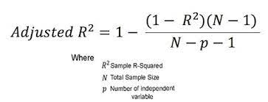
Model Building & Evaluation
• Experimented with linear, ridge & lasso regression models & Tree models such as Decision Tree, Random Forest and Boosting model as Gradient Boosting.
• Xgboost regressor is the best model followed by the random forest regressor model.
• Evaluation as per R2-score, Adj. R2-score & RMSE value

Slide 10
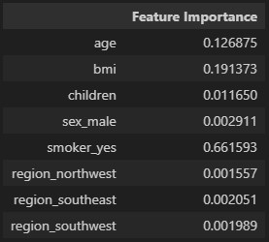
Feature Importance
• GradientBoostingRegressor
Feature importance is calculated as the decrease in node impurity weighted by the probability of reaching that node. The node probability can be calculated by the number of samples that reach the node, divided by the total number of samples. The higher the vales the more important the feature

Slide 11
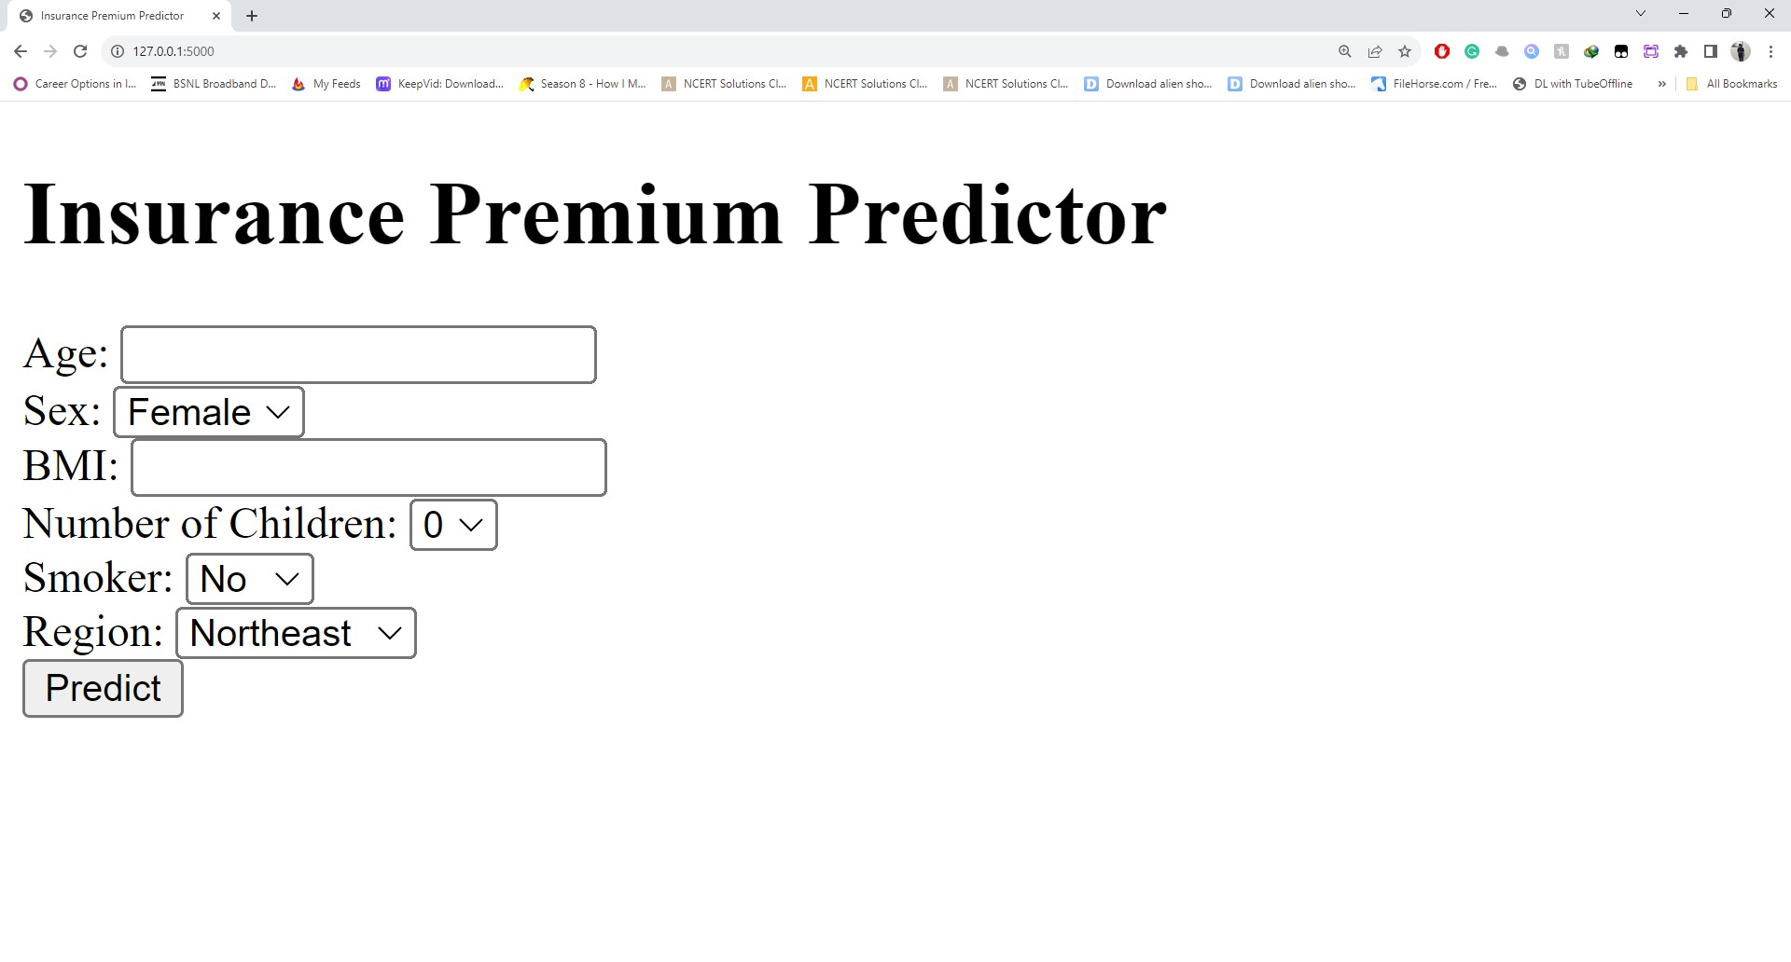
Model Deployment
Saved GradientBoostingRegressor model and the Random Forest regressor model into the “models” directory. Then deployed the Xgboost regressor model using the Flask and linked to web application which was designed using HTML 5.

Slide 12
Key Performance Indicator (KPI)
• Time and workload reduction using the regression models.
• Comparison of the R2 scores and the Adjusted R2 scores of the model on both the training and the testing data.
• Comparison of the RMSE scores of the model on both the training and the testing data.

Slide 13
Q & A
• How are logs managed?
Answer: The entire project is divided into two stages - the development stage and
the deployment stage. The logs recorded during the development stage are stored in the "development_logs.log" file while the logs recorded during the local deployment are stored in the "deployment_logs.log" file.
• Explain importance of virtual environment?
Answer: Virtual environment gives us an independent platform to decouple and
isolate versions of Python and its associated pip packages. This allows end-users to install and manage their own set of packages that are independent of those provided by the system.

Slide 14
Q & A
• Why we use branch in git?
Answer:
- A branch represents an independent line of development. A branch to isolate development
work without affecting other branches in the repository
- The git branch command lets you create, list, rename, and delete branches. It doesn't let you switch between branches or put a forked history back together again. For this reason, git branch is tightly integrated with the git checkout and git merge commands.

